Slide 1
Class 1: Introduction and Overview
Advanced Cognitive Modeling

Slide 2
In this course you will learn to
1) Build cognitive models (from papers)
2) Evaluate and compare cognitive models
3) Make inferences from cognitive models

Slide 3
In this course you will learn to
1) Build cognitive models (from papers)
Translate from equations and text into modelling code
2) Evaluate and compare cognitive models
3) Make inferences from cognitive models

Slide 4
In this course you will learn to
1) Build cognitive models (from papers)
Translate from equations and text into modelling code
2) Evaluate and compare cognitive models
Main focus of course: A priori checks of model quality
3) Make inferences from cognitive models

Slide 5
In this course you will learn to
1) Build cognitive models (from papers)
Translate from equations and text into modelling code
2) Evaluate and compare cognitive models
Main focus of course: A priori checks of model quality
3) Make inferences from cognitive models
Group and individual differences

Slide 6
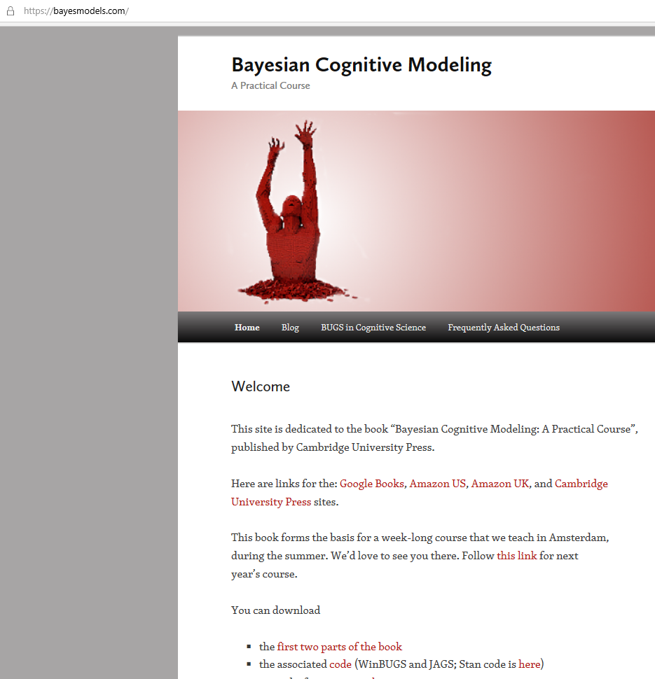
Framework: Bayesian Cognitive Modeling
Heirarchical Bayesian Inference
Your experience: Stan
We’ll use: JAGS
I am more comfortable
Syntactically closer to simulation code we’ll use to build models
Latent mixtures for individual differences
Knowledge can translate

Slide 7
Why learn cognitive modelling?
Posterior inference
Make predictions about individual’s behavior based on specific causal theory of underlying cognitive processing
Marketing, screening (e.g. problem gambling), design, administration, etc
Comparative analysis
Explain differences between people in terms of differences in parameters of models, or differences in cognitive strategy
Clinical, social context, and interaction
Generality
Use the framework and software you learn here to apply theory in any domain to any data set (as long as it scales)

Slide 8
Lee – personal correspondance
“If you give a data scientist some data from Netflix, they’ll analyse it using logistic regression, support vector machines, maybe some neural networks…..
…if you give a data scientist some data from Twitter, they’ll analyse it using logistic regression, support vector machines, maybe some neural networks.”
Implication: cognitive modelers have the ability to think theoretically about the problems they have to solve, and to implement that thinking in their analysis.

Slide 9
Cognitive modeling as integration
Theory
Measurement
Cognitive Model
Data
Experimental Design

Slide 10
What is(n’t) Cognitive Modeling?

Slide 11
Definition
Cognitive Model: A formal theory of the cognitive process which generates behavior on some task or set of tasks
A mathematical formalization of a verbal theory of the internal causes of human behavior

Slide 12
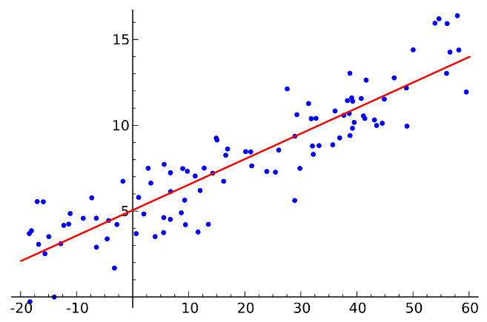
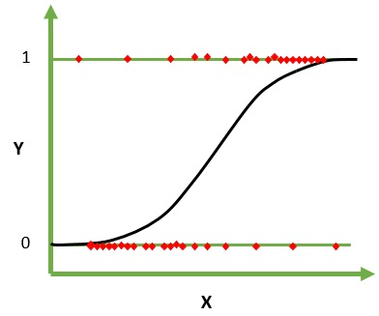
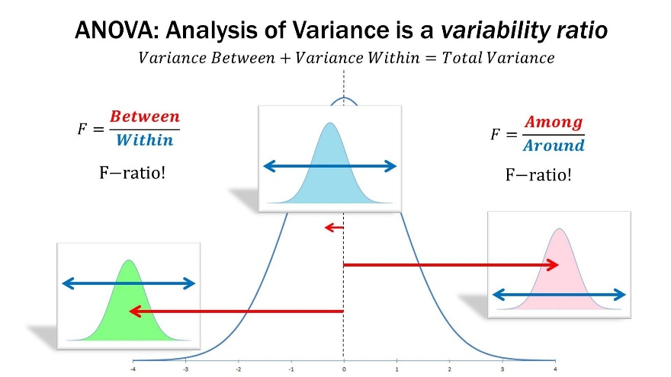
Not cognitive models
Statistical models
Linear regression
Logistic regression
ANOVA
Atheoretical descriptions of data
There may be linear or logistic components in cognitive models

Slide 13
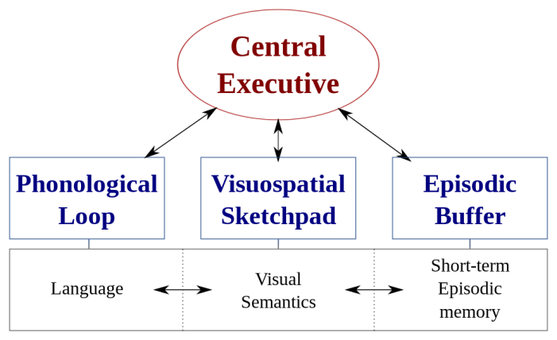
Not cognitive models
Verbal models
Dual process theory
Lavie’s load theory
Baddeley’s theory
Provide a starting point for development of new models

Slide 14
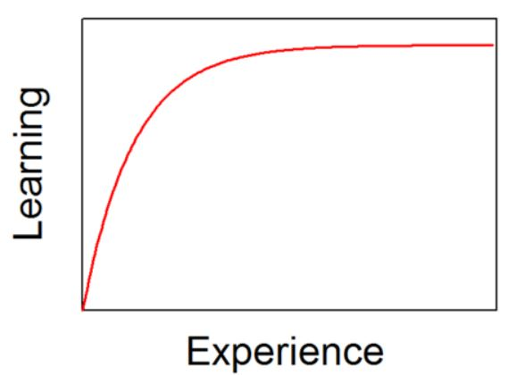
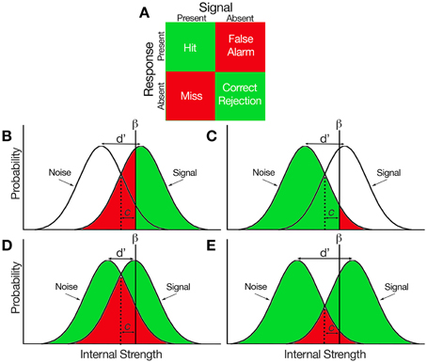
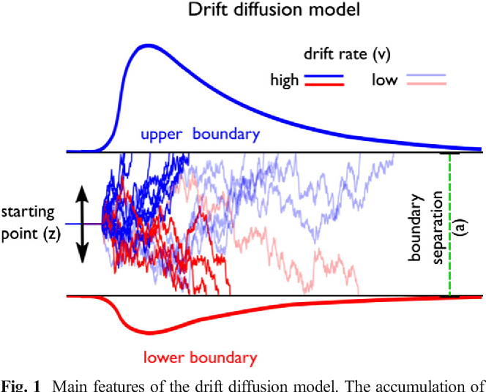
Maybe cognitive models
Measurement models
Power law of practice
Signal detection theory
Drift diffusion
May be interpreted as cognitive models in some contexts.
Requires causal interpretation.

Slide 15
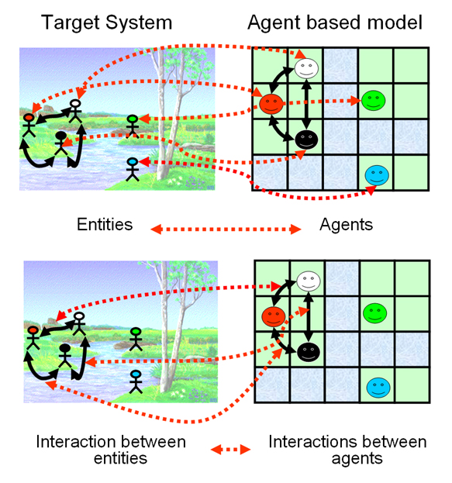
Not (necessarily) cognitive models
Deterministic models
Agent based models
Game theoretic models (analytic derivations of e.g. Nash equilibria)
Requires causal interpretation, and possibility for inference (i.e. likelihood function).

Slide 16
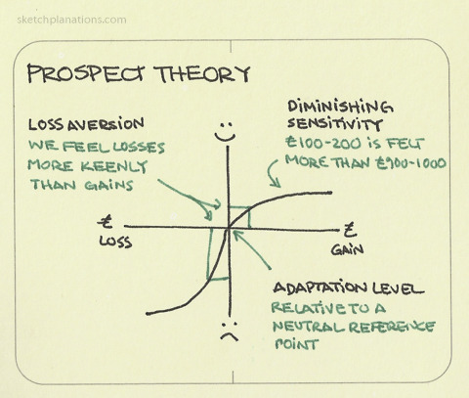
Discussion
Is prospect theory a cognitive model? Why or why not? When or when not? If not, then what sort of model is it?

Slide 17
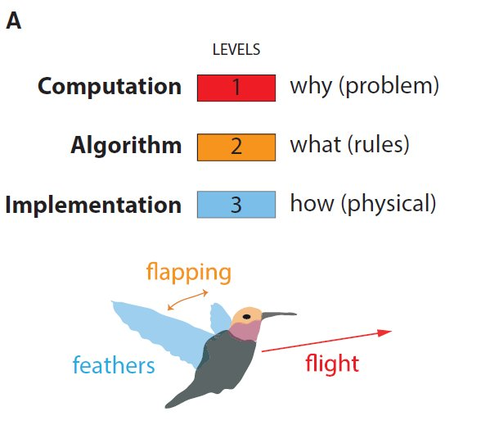
What do cognitive models represent?
Marr’s three levels of analysis
Different kinds of cognitive models represent different levels of analysis
Krakauer et al, 2017

Slide 18
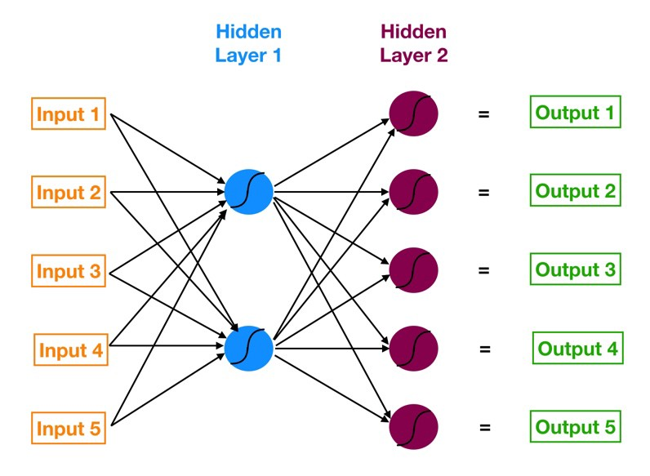
Neural network
Model parameters – weights on nodes
Fitting only works for very simple networks – scale poorly
Implementation, algorithm, and computational level

Slide 19
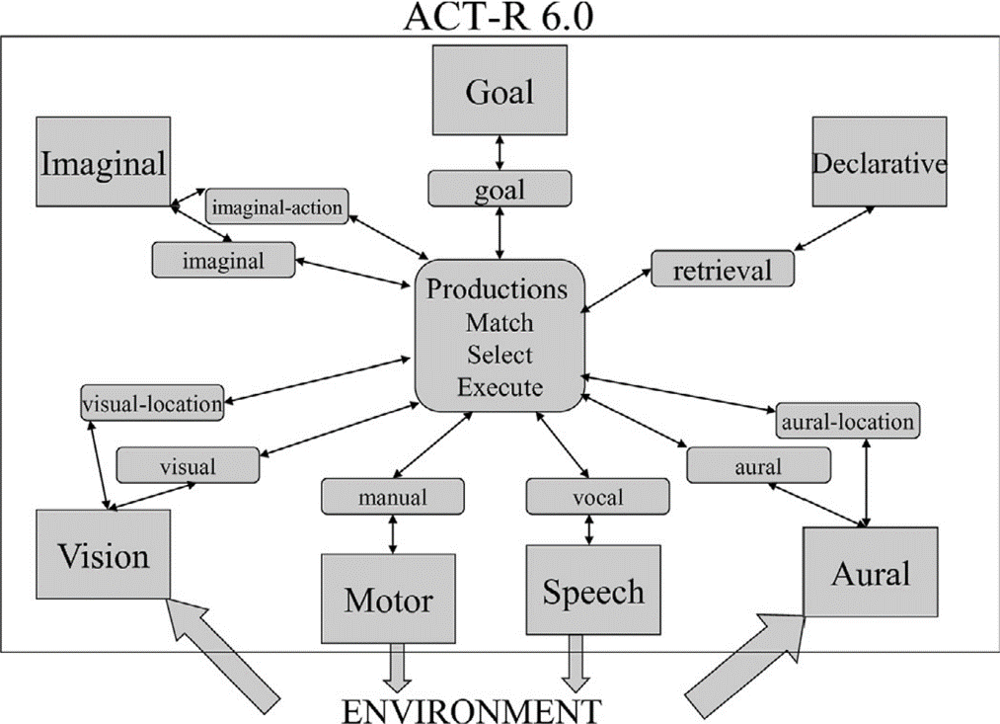
Cognitive architecture
Some higher level functions hard coded (in LISP) – can’t be fit to data
Good for inspiration and constraining model development – e.g. instance based learning theory
Algorithm and computational levels

Slide 20
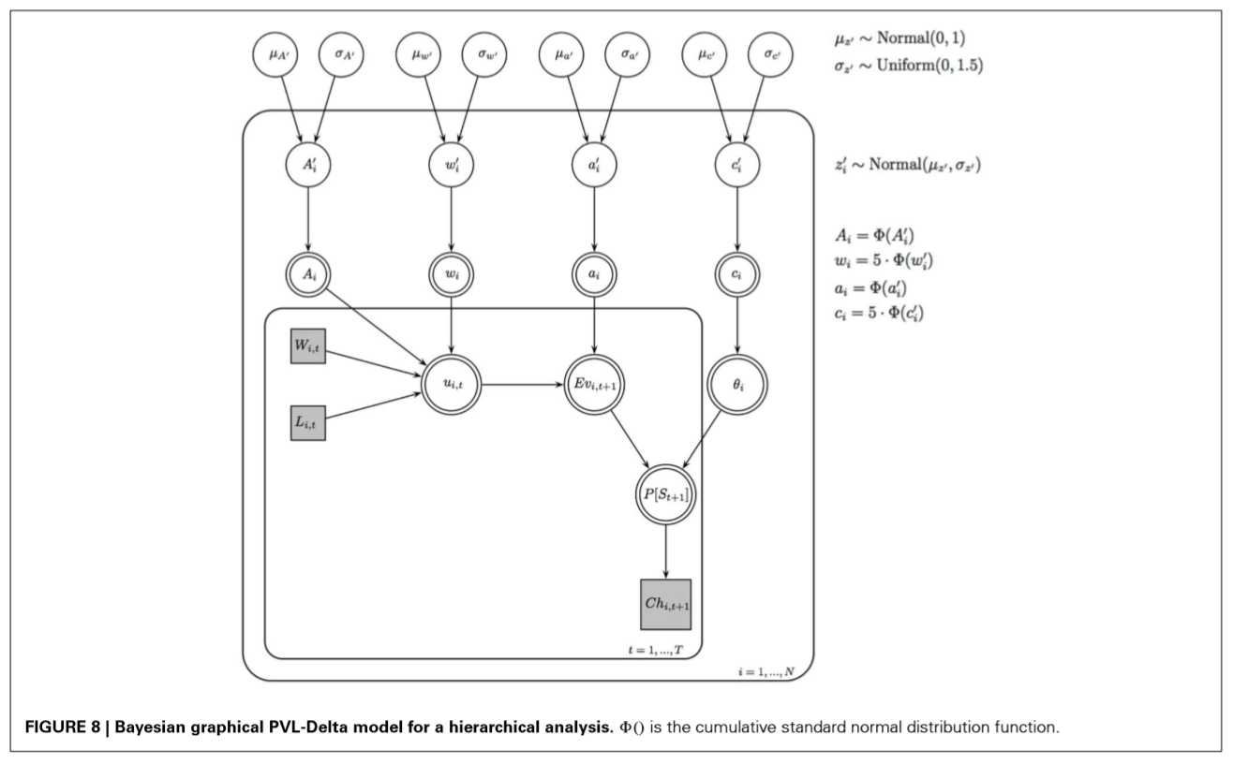
Graphical models
Can write neural networks as graphical models – computationally inefficient
Can write ACT-R equations using graphical models
You’ve done this using Stan
Computational level
Main topic for next class

Slide 21
Our aim and approach
To learn how to develop formalized cognitive theories
That can be used to make direct inferences and predictions about behavior
Inference: The process of expressing and updating beliefs about the cognitive processes generating behavior
Requires: Models that can be applied to data – Bayesian methods

Slide 22
Our aim and approach
Neural networks: Scale poorly and don’t fit well to data
Full cognitive architectures: Deterministic componenets, can’t be fit to data for the purpose of inference – interesting research career
Relatively simple graphical models – simulation in R, inference using JAGS

Slide 23
What will we learn about developing good models?

Slide 24
A priori criteria
Explain behavior that matters
Theoretically meaningful and interpretable – choice of model structure and parameters not arbitrary, designed to capture causal theory
Not interchangeable with other models – if you knew your model was true, could you distinguish inference from it from false alternatives?
Meaningful and interpretable parameters – if you knew the true values of your model’s parameters, could you infer them accurately and precisely from data?

Slide 25
A posterior criteria
Does your model explain the data well?
Does your model predict new and interesting phenomena?

Slide 26
What you will get out of this class
The ability to start building good cognitive models
The ability to
take a verbal description of any kind of data generating process
develop a reasonable formalization of that process
evaluate the quality of the formalization both a priori and a posteriori, and
apply the formalization in inference at individual and group levels….
….. or at least to start doing this

Slide 27
Class activities - Reading
Minimal assigned reading
You will need to read papers closely
You will need to read papers multiple times
I will assign additional readings to address your questions
All materials available via links in the syllabus

Slide 28
Class activities - Lectures
Very few lectures
Focused on theory behind models
Some methods and representation

Slide 29
Class activities – Live coding and demos
Personal teaching experiment: Develop models together as a group
More common methods that we won’t use:
Incomplete code that needs to be completed
Complete code with questions
What we’ll do instead:
Develop functions, forward simulations, and models together from scratch
Think aloud
Come to class, follow as closely as possible, stop me with questions

Slide 30
Class activities – a priori evaluation
Focus on a priori criteria of good models – not so much data
Evaluating and discussing whether our models are interpretable and meaningful
A lot of simulations and model checks, before we apply our models to data

Slide 31
Class activities – Portfolio exams
2-3 pages of text – 5 portfolios
Explain the task being modeled
Explain how the equations we’ll use implement a formal theory of the task, with appropriate reference to papers
Explain how you evaluate your models, present relevant analysis outputs, and reach critical conclusions about the model and the task

Slide 32
Class activities – Writing workshops
A writing workshop for each portfolio
In class supervision on writing up
Time to catch up if we lag behind

Slide 33
Course outline

Slide 34
Course modules - portfolios
1) Building models – Class 2-5
2) Modeling decision making – Class 6-9
3) Case study on the Iowa Gambling Task – Class 10-15
4) Combining cognitive and agent based models – Class 16-21
5) Group and individual inference – Class 22-24

Slide 35
Class 2: Model building - Lecture
Introduction to graphical modeling
Plate notation
Building models using distributions
Models as functions
Other terminology

Slide 36
Class 3: Model building – Live coding
Coding a simple binomial choice model
Coding a simple learning model
Inferring parameters
Model recovery
Parameter recovery

Slide 37
Class 4: Writing workshop
Writing up simple model recovery and parameter recover study

Slide 38
Class 5: Modeling decisions – Lecture
Theoretical foundations in learning and choice for modeling simple decisions
Luce’s choice axiom
Rescorla Wagner model of reinforcement learning
Basic bandit model of binary choice

Slide 39
Class 6: Modeling decisions – Live coding
Applying principles of good modeling practice
Forward simulation of some different models of binary choice
Coding up models in the “Ten Simple Rules” paper
Building models as re-usable functions…

Slide 40
Class 7: Modeling decisions – Live coding
Model recovery – making sure our models are interpretable and identifiable
Parameter recovery – making sure our inferences about parameter values are reasonable

Slide 41
Class 8: Writing workshop
Explanation of models in context of learning theory and choice axioms
Reporting model recovery
Reporting parameter recovery

Slide 42
Class 9: Iowa Gambling Task - Lecture
Prospect Valence Learning-Delta Model
Outcome Representation Learning Model
Value plus Sequential Exploration Model

Slide 43
Class 10 – 14: IGT models
Build model functions
Conduct model recovery study
Conduct parameter recovery studies
Apply to data – model comparison
Apply to data – inference
Portfolio

Slide 44
Class 15: Theories of Public Goods Games
Theoretical background – importance, game theoretic equilibria, and main empirical phenomena
Classes of explanation of phenomena – Individualistic versus minimally social explanations of public goods interactions
Conditional co-operation model
Experience weighted attraction model

Slide 45
Class 16 – 20: Public Goods Models
Build model functions
Conduct model recovery study
Conduct parameter recovery studies
Apply to data – model comparison
Apply to data – inference
Portfolio

Slide 46
Class 21: Heirarchical modeling and group comparison
Heirarchical model of IGT behavior
Bayesian t-test
Calculate Bayes factors to infer group differences

Slide 47
Class 22-23: Latent mixtures and individual differences
Latent mixture model of public goods behavior
Systematic modeling of individual differences in cognitive processes (and not just parameters)
New directions in cognitive modeling ….
…..from the search for true models of fixed cognitive processes, to the attempt to define and categorise cognitive strategies

Slide 48
Class 24: writing workshop or finishing up

